Slide 1

RevoGracers Sales Performance Analysis
Faturachman N
Team 2 – RevoU FSDA

Slide 2

Agenda
Business Overview & Disclaimer
Dataset Overview
Project Goal
Data Analysis

Slide 3


Business Overview & Disclaimer
A fictional grocery retail business operating in multiple locations, focused on sales strategy, customer experience, and data-driven revenue growth.

Slide 4
Disclaimer
This analysis is based on a public dataset from Kaggle:
Kaggle Grocery Sales Dataset
RevoGrocers is a fictional company created for analytical purposes.
Any insights or recommendations are based on this dataset and do not reflect real-world data.

Slide 5
Dataset Overview
Key Tables Used
Sales (transactional data)
Product (products details)
Categories (product category information)
Relevant Field
Quantity (units sold)
Price (unit price)
Category Name (product category)
CustomerID (unique buyers)

Slide 6
Project Goal
Identify the most profitable categories
Assess revenue correlations (units sold, customers, price)
Analyze repeat purchase patterns
Provide data-driven insights for strategic decisions

Slide 7

Data Analysis

Slide 8
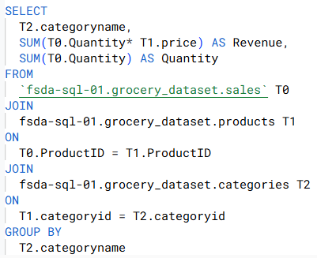
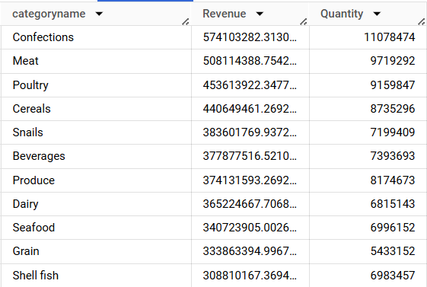
Product categories with the highest revenue
Top Revenue Categories
🥇 Confections (57.4B) – Highest revenue generator
🥈 Meat (50.8B)
🥉 Poultry (45.3B) & Cereals (44.1B)
Strategic Recommendations
Focus on top-performing categories (Confections & Meat) for promotions and stock optimization
Analyze pricing and demand factors for lower-revenue categories to improve profitability
Investigate seasonal trends in product categories to maximize sales opportunities

Slide 9
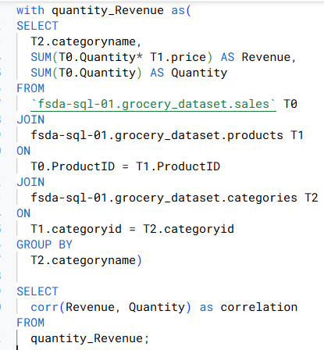
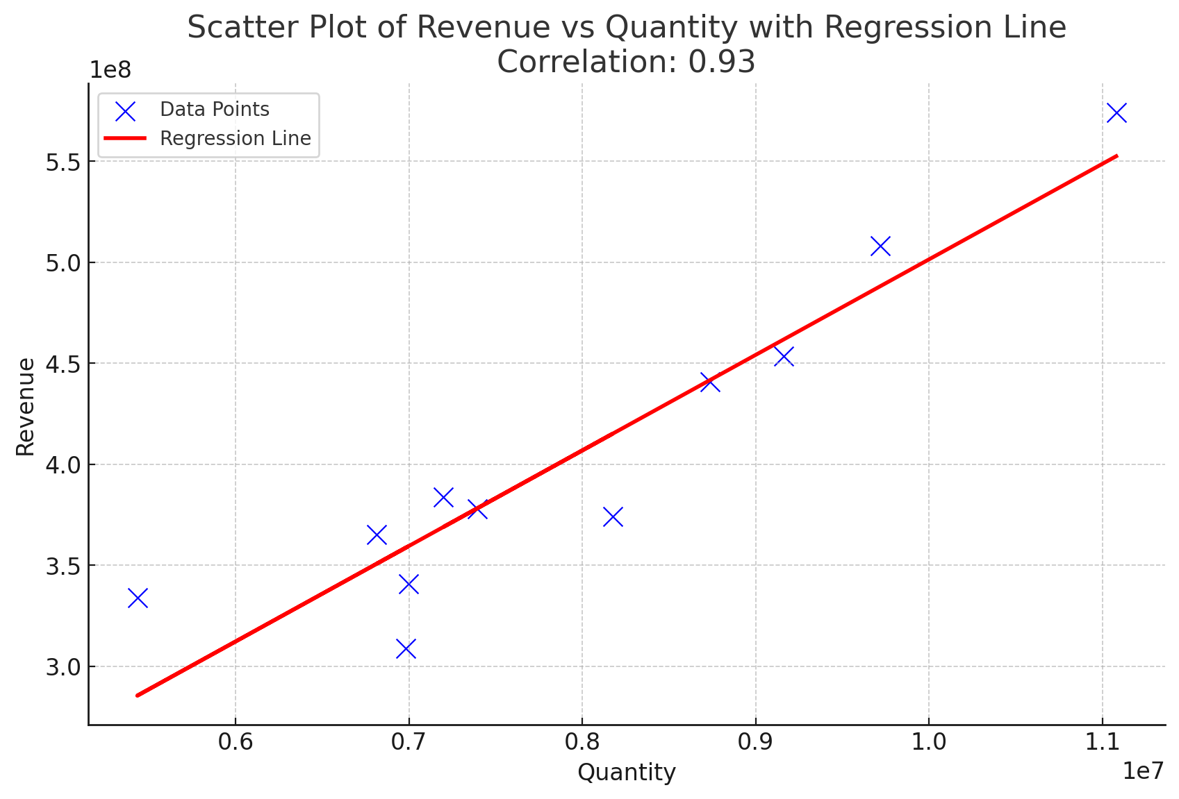
Correlation between Revenue and Total Units Sold for Each Category
Strong Positive Correlation (0.93): Higher quantity sold leads to higher revenue.
Linear Trend: Most data points align with the regression line.
Potential Pricing Differences: Some categories may have high revenue with low quantity (premium pricing).

Slide 10
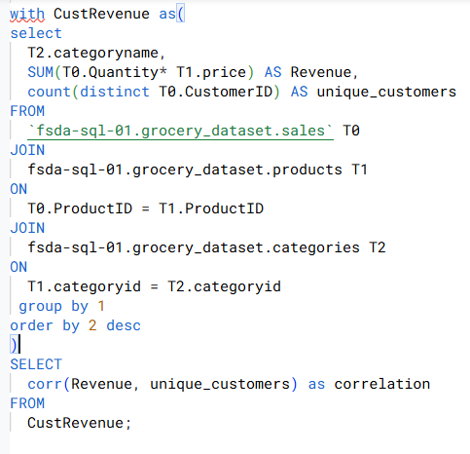
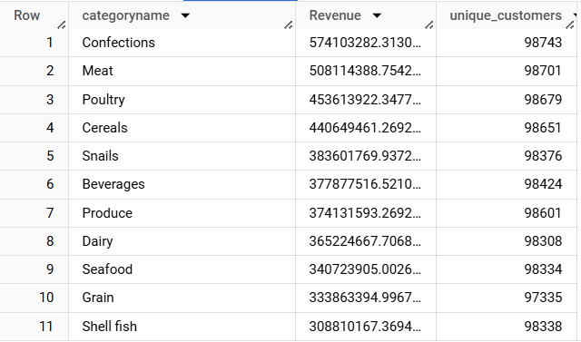

Correlation between Revenue and The Number of Unique Customers Sold for Each Category
Insights
Moderate Positive Correlation (0.62): More unique customers tend to generate higher revenue, but the relationship is not as strong as Quantity vs. Revenue.
Possible Customer Behavior Differences: Categories with high revenue but fewer unique customers may indicate repeat purchases or higher-value products.
Recommendations:
Identify high-revenue categories with fewer unique customers to explore loyalty strategies.

Slide 11
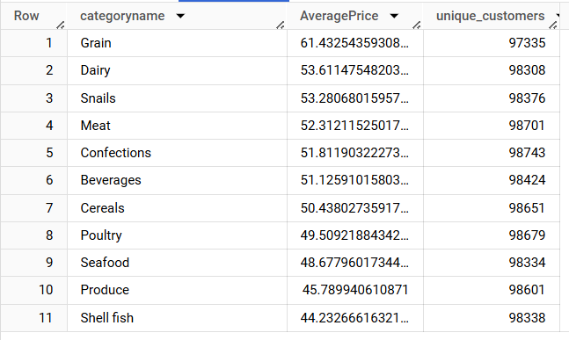
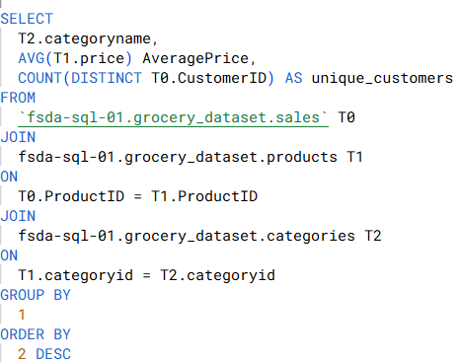
Average Price for Each Product Categories
Highest Price Categories 🚀
Grain (61.43), Dairy (53.61), Snails (53.28) → Premium pricing
Meat (52.31) & Confections (51.81) → Strong revenue drivers
Lowest Price Categories 🔻
Shellfish (44.23) & Produce (45.78) → Lowest pricing, potential volume focus
Seafood (48.67) & Poultry (49.50) → Lower than other protein sources
Key Takeaways 🎯
Meat & Confections thrive despite mid-range prices → High sales volume
Grain is the most expensive but not top in revenue → Check demand impact
Boost lower-priced categories with promotions/bundling

Slide 12
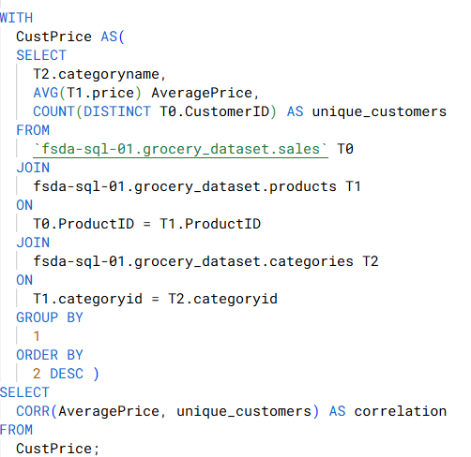
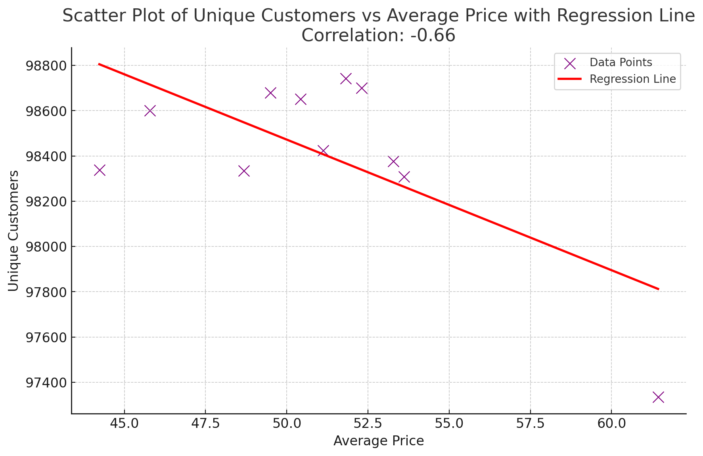

Correlation between the Average Price per Unit and The Number of Buyers
Key Insights
Negative Correlation (-0.66): Higher prices tend to reduce unique customers.
Price Sensitivity: Lower-priced categories attract more customers.
Recommendations:
Monitor high-priced categories for customer drop.
Adjust pricing or offer promotions to boost appeal.

Slide 13
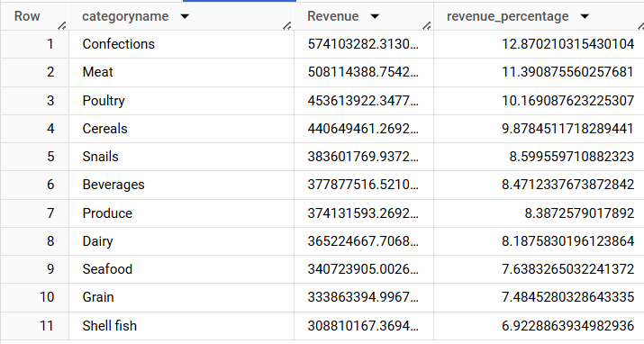
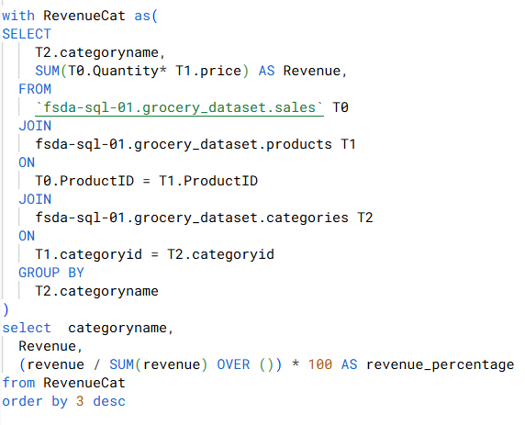
Categories that Contribute the Most to Overall Revenue
Key Insights
Top Contributors: Confections (12.87%), Meat (11.39%), and Poultry (10.17%) lead in revenue share.
Lower Shares: Shell fish (6.92%) and Grain (7.48%) contribute the least.
Relatively Even Spread: No single category overwhelmingly dominates.

Slide 14
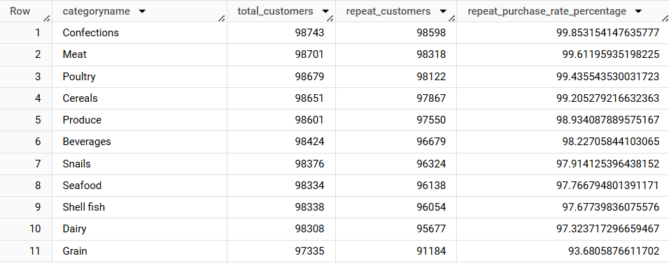
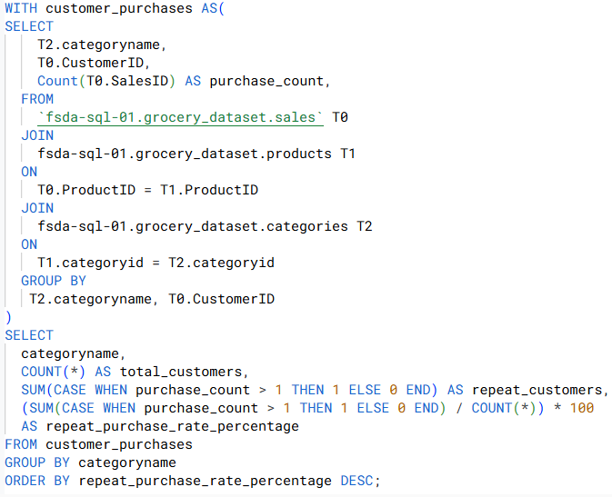
Product Categories With The Highest Repeat Purchase Rates
Key Insights
Generally High Repeat Purchase Rate: Most categories exceed 90%, indicating strong customer loyalty.
Top Performer: Confections has the highest repeat purchase rate (~99.85%), suggesting consistent re-purchases.
Lowest Among the High: Grain is at ~93.60%, still high but relatively lower compared to other categories.

Slide 15
Summary
Top Revenue Categories:
Confections (12.87%), Meat (11.39%), Poultry (10.17%)
Correlations:
Revenue vs. Quantity: Strong positive (0.93)
Revenue vs. Unique Customers: Moderate positive (0.62)
Average Price vs. Unique Customers: Moderate negative (-0.66)
Repeat Purchase:
90% across categories, highest in Confections (~99.85%)
Recommendations:
Focus on top revenue performers
Review pricing strategies for high-priced categories
Enhance loyalty programs to maintain high repeat purchases

Slide 16

Thank you

